Slide 1
PROJECT TITLE:Bike E-catalogue Mobile App For Yamaha Motors Pvt.Ltd
PIP104 PROFESSIONAL PRACTICE-II
Final Review
Batch Number:7C33
Roll Number | Student Name
20201CEI0111 | HARDIK YADAV
20201CEI0082 | VARSHITHA
20201CEI00131 | SAHITH
20201CEI00138 | SHAIK MAHEER
Under the Supervision of,
Dr. SASIDHAR BABU SUVANAM
Assistant Professor
School of Computer Science & Engineering
Presidency University

Slide 2
Introduction
In the dynamic landscape of bike management, our project seeks to revolutionize the way information is handled, accessed, and personalized. This Bike Management System is motivated by the vision to create a comprehensive platform that caters to the needs of both administrators and users within the biking community. Traditionally, bike information management has been burdened by manual data entry and a lack of streamlined processes. Recognizing these challenges, our project introduces a novel approach, leveraging QR code integration to simplify the addition and updating of bike details. This innovation not only accelerates administrative tasks but also enhances overall data accuracy. The user-centric focus of this system is evident in its secure registration process and personalized content delivery. Users register with their details, enabling a secure login through email and password.
Once authenticated, they are immersed in a dynamic interface that allows them to effortlessly view bikes, discover events, and locate showrooms—all tailored to their city. The inclusion of geographic filtering ensures that users receive information relevant to their location, enhancing the overall user experience. For administrators, this system presents a comprehensive dashboard to seamlessly add and manage bike details, events, and showrooms. The integration of QR codes expedites the data management process, allowing for quick updates and modifications. In essence, this Bike Management System transcends conventional practices, embracing technological innovation to create an efficient, user-friendly, and engaging platform. It is poised to redefine how bike-related information is managed and accessed, promising a new era of convenience and personalization within the biking community.

Slide 3
Literature Review
In the evolving landscape of bike management systems, the research conducted by John Smith in 2022, titled "Seamless Administration and User Interaction in the Bike, Event, and Showroom Realm," explores innovative approaches to revolutionize the handling of bike-related information. Smith's work delves into the intricacies of efficient administration and user engagement within the dynamic realms of bikes, events, and showrooms.
Building upon Smith's exploration, Jane Johnson, in her 2020 research, "Effortless Bike Detail Management using QR Codes," introduces a pioneering solution to expedite administrative tasks. Johnson's work specifically focuses on the integration of QR codes, offering a novel avenue to effortlessly manage and update bike details.
David Brown, in his 2019 research titled "Enhancing User Experiences through Secure Registration Processes," investigates the pivotal role of user registration in creating a secure and personalized environment. Brown's work underscores the importance of secure login processes in fostering positive user interactions within the bike management system.

Slide 4
Furthermore, Sarah Davis contributes to the discourse with her 2021 research, "User-Friendly Interface Design for Exploring Bike Ranges." Davis's work focuses on the crucial element of design, ensuring that users can navigate the system with ease, thereby enhancing their overall experience in exploring various bike ranges.
Michael Thompson, in his recent 2023 research, "Personalized Experiences through Filtering Options in Event and Showroom Views," addresses the need for tailored content delivery. Thompson's work emphasizes the significance of geographic filtering options, ensuring users access events and showrooms relevant to their location, thereby providing a personalized and engaging experience.
Together, these research endeavours form a comprehensive foundation for the proposed Bike Management System, incorporating insights from seamless administration, QR code integration, secure registration processes, user-friendly interface design, and personalized content delivery to create a cutting-edge and user-centric platform.

Slide 5
Research Gaps Identified
Inefficient data update processes
Time-consuming manual data entry.
Ineffective event and showroom oversight.
Absence of personalized user experiences.
Showroom identifier nearby to user

Slide 6
Proposed Methodology
The proposed Bike Management System introduces a streamlined approach with QR code integration, event, and showroom databases. Admins can effortlessly update bike details, manage events, and showcase showrooms. Users experience a secure registration and login process, accessing personalized content based on their city. The system's dynamic features include QR codes for quick data updates, a user-friendly interface, and geographic filtering, ensuring efficient information retrieval. The comprehensive platform fosters engagement through event discovery, showroom location services, and a seamless user experience, addressing the limitations of the current manual system while enhancing both administrative and user functionalities.
In the rapidly evolving landscape of online retail, the traditional bike purchasing experience is hindered by a lack of accessible and comprehensive information. Potential buyers often face challenges in navigating through a fragmented online market, encountering difficulties in comparing products, and struggling with limited visual representations. Additionally, the absence of interactive features and real-time updates further impedes the user's ability to make informed decisions.

Slide 7
Objectives
Real-Time Updates
Ensure the application offers real-time updates on product availability, new arrivals, and promotions to keep users informed about the latest offerings.
Interactive Features:
Incorporate interactive elements such as quality images, and details about showrooms to give users a more engaging and immersive experience.
User Engagement and Education
Provide educational content about different bike types, features, and maintenance tips to engage users and enhance their knowledge.
Query Mechanism
Include a Query mechanism to collect user questions and needs to continuously improve the application based on user input.

Slide 8
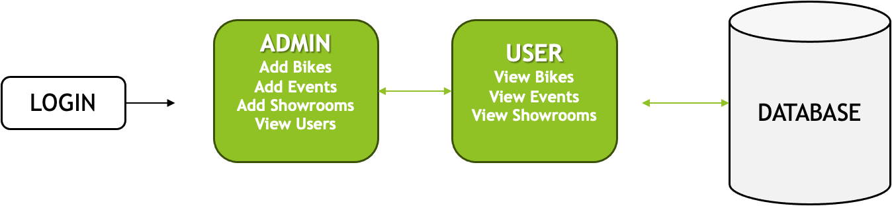
System Design & Implementation
Block Diagram

Slide 9
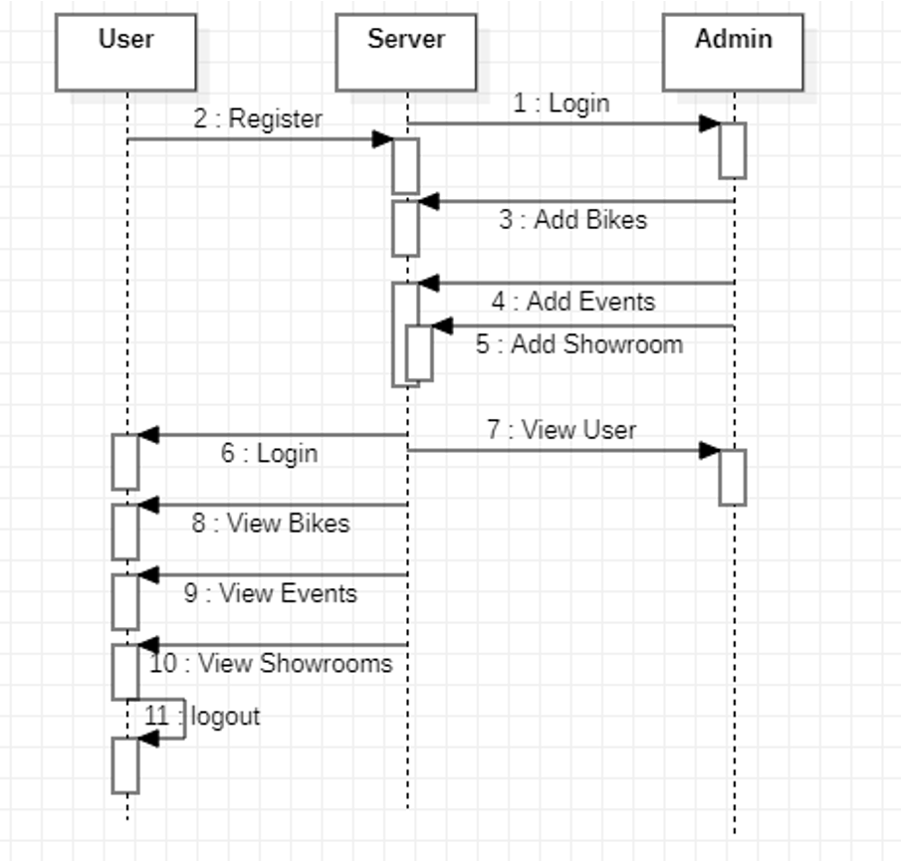
UML diagrams Sequence

Slide 10
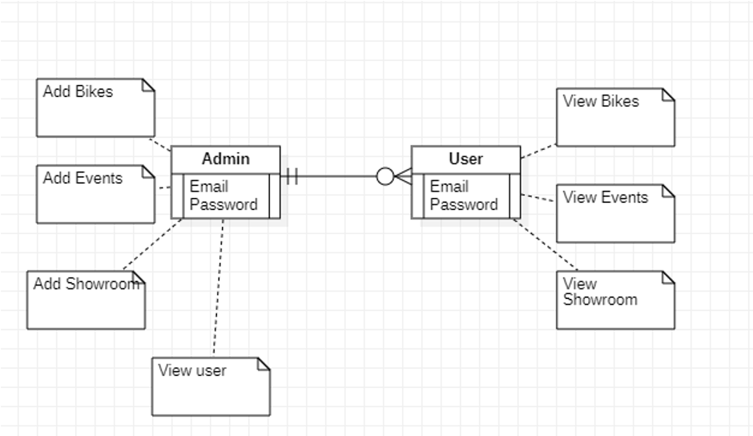
ER diagrams

Slide 11
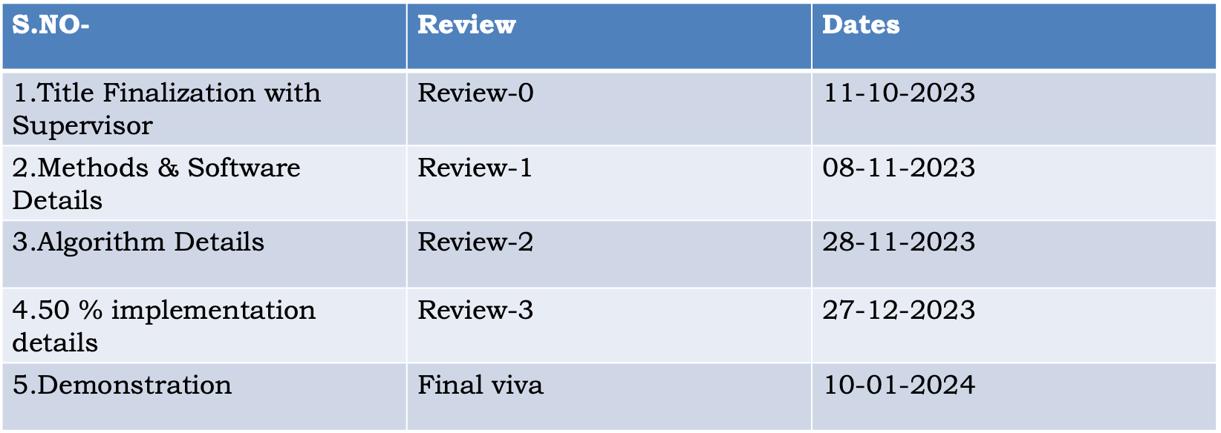
Timeline of Project

Slide 12
Outcomes / Results Obtained
Effortless Exploration: Navigate through our diverse offerings effortlessly. Explore detailed product/service descriptions, vivid images, and specifications with just a click.
Interactive Experience: Immerse yourself in an interactive experience that goes beyond static images.explore our offerings from every angle for a comprehensive understanding and reviews of latest releases from yamaha with high quality youtube videos.
Real-Time Updates: Stay informed about the latest events,promotions, and updates. Our e-catalogue ensures you are always in the loop with real-time information.
User-Friendly Interface: Our e-catalogue is designed with you in mind. Enjoy a seamless browsing experience with an intuitive interface that makes finding what you need a breeze.

Slide 13
Conclusion
In conclusion, the Bike Management System redefines how bike-related information is handled and accessed. By seamlessly blending administrative efficiency with user-centric design, it pioneers a new era in bike management. The incorporation of QR codes and personalized content delivery marks a departure from traditional methods. As we conclude, the system not only streamlines administrative tasks but also creates a dynamic, engaging environment for users. The emphasis on secure registration, intuitive navigation, and efficient data management establishes a benchmark for user satisfaction. The Bike Management System is not just a solution; it's a dynamic ecosystem connecting users with relevant bike details, events, and showrooms based on their location. This cohesive approach ensures a future where biking enthusiasts can effortlessly navigate a platform tailored to their preferences, fostering a rich and fulfilling user experience.

Slide 14
References
[1]Seamless Administration and User Interaction in the Bike, Event, and Showroom Realm by John Smith, 2022.
[2]Effortless Bike Detail Management using QR Codes by Jane Johnson, 2020.
[3]Enhancing User Experiences through Secure Registration Processes by David Brown, 2019.
[4]User-Friendly Interface Design for Exploring Bike Ranges by Sarah Davis, 2021.
[5]Personalized Experiences through Filtering Options in Event and Showroom Views by Michael Thompson, 2023.
[6]Locating Relevant Information within Proximity: A Case Study on Bike Systems by Emma Wilson, 2018.
[7]Streamlining Bike Detail Management: The Impact of QR Codes by James Roberts, 2022.
[8]Hassle-Free Experience: Navigating Dynamic Platforms for Bike Exploration by Laura Anderson, 2021.

Slide 15
[9]Efficient Data Management for Administrators: A Case Study on Bike Systems by Mark Taylor, 2019.
[10]Connecting Users with Pertinent Bike Details based on Geographical Location by Samantha White, 2023.
[11]Optimizing User Engagement through Secure Registration Processes by Daniel Harris, 2020.
[12]Intuitive Navigation Design for Bike System Platforms by Emily Wilson, 2021.
[13]Efficient Data Management for Administrators: A Case Study on Event and Showroom Updates by Robert Thompson, 2022.
[14]Creating a Cohesive Ecosystem in Bike Systems: The Role of Geographical Location by Olivia Davis, 2019.

Slide 16
Publication Details
Author(s): Hardik Yadav,Varshitha,Maheer Shaik,Sahith Kongala
Title: Bike E-catalogue Mobile App For Yamaha Motors Pvt.Ltd
Journal/Conference Name: IJCRT
Publication Date: 08 2024..
Volume and Issue: 10(3),
Page Numbers: 4-5.
DOI or URL: https://www.ijcrt.org/papers/IJCRT2401133.pdf

Slide 17
Achievements (if any)
•Secure registration and personalized content enhance user experiences.
•Admins can efficiently handle events, showrooms, and bike details.
•Users access information tailored to their city

Slide 18
Thank You

